Slide 1
Performance Management

Slide 2
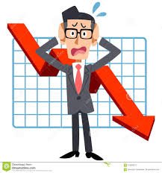

What is performance
Good Performance
Poor Performance

Slide 3
What is performance
What has been achieved?
How it has been achieved?
Have you achieved your objectives ?

Slide 4
Performance Management
A process for establishing a shared understanding about what is to be achieved and how it is to be achieved, and an approach to managing people that increases the probability of achieving success.

Slide 5
Why to manage performance
Provide the basis for personal development
Align individual and organizational objectives
Develop a performance culture
Improve individual performance

Slide 6

PM Characteristics
Agreement
Measurement
Feedback
Dialogue
Reinforcement

Slide 7
PM Characteristics
It is not something that is done to people, is done for people and in partnership with them

Slide 8
PM Elements
Setting (SMART) Objectives
PDP
Annual Performance Review
Performance Appraisal
Performance Rating
Learning and Development
Performance related pay
360º feedback

Slide 9
SMART Objectives
الأهداف الذكية (سمارت)
S
M
A
S
T
Specific
Measurable
Attainable/ achievable
Realistic
Time-bound

Slide 10
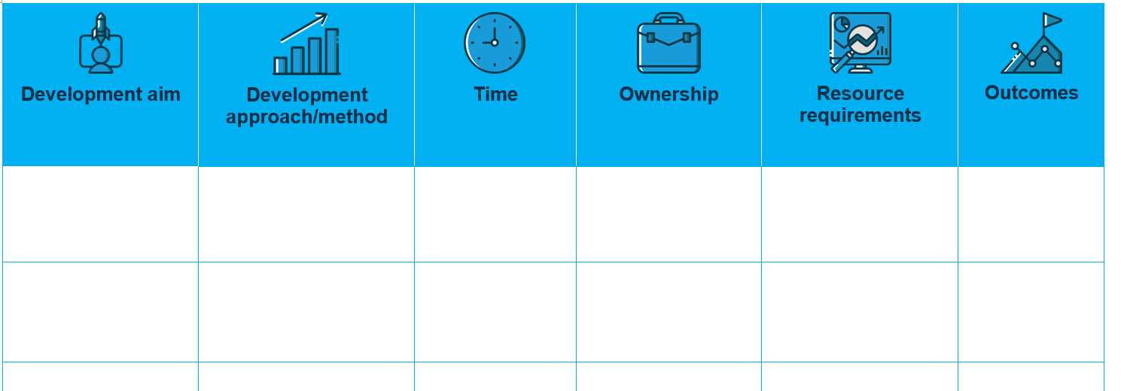
Personal Development Plan

Slide 11
Individual Performance
Motivation
Ability
OTP

Slide 12

Motivation
A motive is a reason for doing something

Slide 13
Motivation
Direction – what a person is trying to do.
Effort – how hard a person is trying.
Persistence – how long a person keeps on trying.

Slide 14
Motivation
التحفيز
Motivation
Intrinsic
Extrinsic

Slide 15
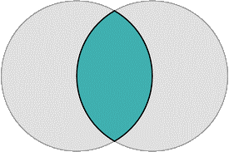
Motivation & PM
Victor vroom (1964)
Performance
Motivation
Ability

Slide 16
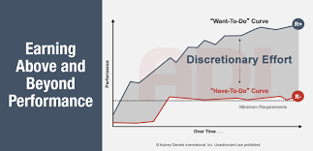
Motivation & PM
Bailey et al., (2001)
Performance

Slide 17
Motivation & PM
Boxall and Purcell (2003)
Ability
Motivation
OTP
Performance
AMO Formula

Slide 18
Motivation
Fredric Herzberg (1959)
Motivational Factors
Hygiene Factors

Slide 19
Motivation
التحفيز
Fredric Herzberg (1959)
Hygiene Factors
Company Policy & Administration.
Supervision.
Interpersonal relationships.
Working conditions.

Slide 20
Motivation
التحفيز
Fredric Herzberg (1959)
Motivational Factors
Achievement and recognition.
The work itself.
Advancement.
Personal Growth.

Slide 21
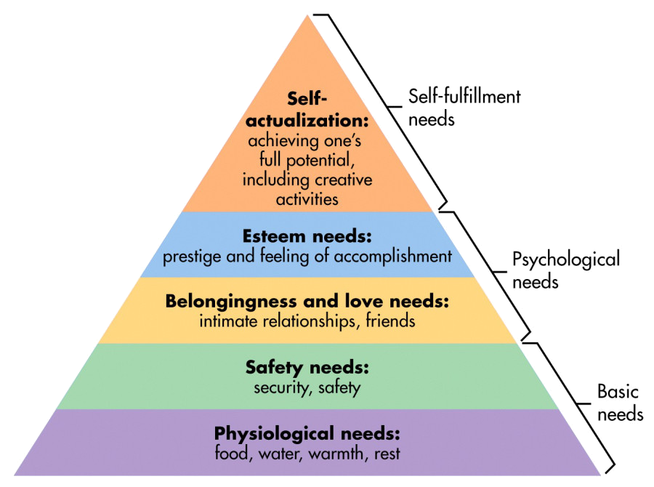
Motivation
Abraham Maslow(1943)

Slide 22
Motivation
Expectancy theory vroom (1964)
Expectancy
Instrumentality
Valence

Slide 23
Motivation
Daniel Pink (2009)
Autonomy
Purpose
Mastery

Slide 24
Competencies
KSA ?
CPD ?

Slide 25
Competencies
Knowledge
Skills
Attitude

Slide 26
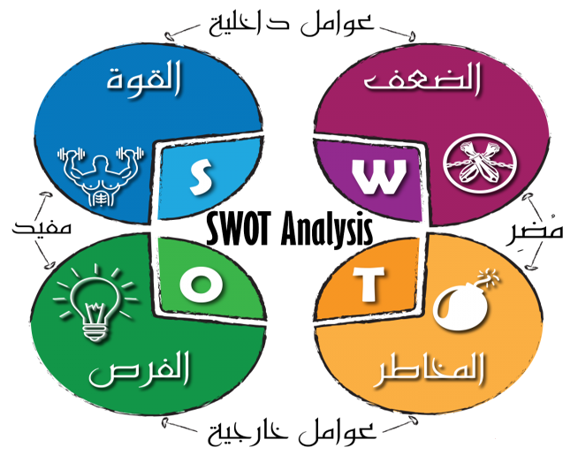

Slide 27
JOHARI
Open
Blind
Hidden
Unknown
Known by others
Unknown by others
Known by self
Unknown by self

Slide 28
JOHARI
Open
Blind
Hidden
Unknown
Known by others
Unknown by others
Known by self
Unknown by self

Slide 29
JOHARI
Open
Blind
Hidden
Unknown
Known by others
Unknown by others
Known by self
Unknown by self

Slide 30

Reflection
consider how we do what we do, why we do it, how we feel about actions we’ve taken – and how all these elements might shape our future behavior

Slide 31

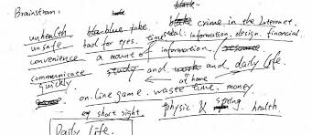
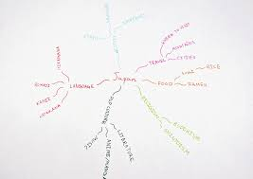
Reflection
Meditation, Exercise
Free Writing
Mind mapping

Slide 32
Reflection
Donald Schön (1983)
On action
In action
Before action
Reflection

Slide 33
Reflection
Terry Borton (1970)
What?
So what ?
Now what?

Slide 34

Reflection
Boud et al., (1985)
Re-evaluating the experience
Behaviors
Ideas
Feelings
New Perspectives

Slide 35
Individual Performance
الأداء الفردي
Motivation
Ability
OTP

Slide 36
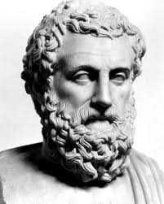
Quote
The roots of education are bitter, but the fruit is sweet (Aristotle)

Slide 37



